Slide 1
WORD
SCRAMBLE
BY:
Gurshaanpreet singh(21103054)
Divyam(21103046)
Amit kumawat(21103011)

Slide 2
WORD SCRAMBLE GAME
WHAT IS IT?
IT IS A GAME IN WHICH THE PLAYER HAS TO UNSCRAMBLE A SCRAMBLE WORD INTO MEANINGFUL WORD.
THIS GAME HAS TWO MODES OF PLAY.
SINGLE PLAYER AND MULTIPLAYER, USER CAN CHOOSE ANY MODE.
IN SINGLE PLAYER MODE, THERE IS AN OPTION TO SELECT THE LEVEL OF GAME FROM EASY TO DIFFICULT, PLAYER CAN SELECT ACCORDING TO IT’S CHOICE.
IN MULTIPLAYER, ONE PLAYER CAN ENTER THE WORD OF IT’S CHOICE, SYSTEM WILL AUTOMATICALLY SCRAMBLE THAT WORD AND SECOND PLAYER HAS TO UNSCRAMBLE THAT WORD.
FINALLY, PLAYER CAN SEE IN HOW MANY ATTEMPTS HE GUESS THE RIGHT WORD.

Slide 3

Header files included:
<stdio.h> → for printf(), scanf(), goto(), fgetc(), getch(), fopen(), fclose(),
<string.h> → strlen(), strcmp(), strlwr(),
<stdlib.h> → for system(“cls”), srand(),
rand(),
<time.h> → for time(),
<ctype.h>
<stdbool.h> → for bool datatype;
<conio.h> → getch(),
<windows.h>

Slide 4
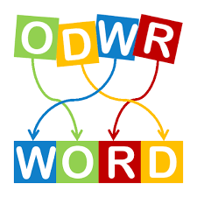
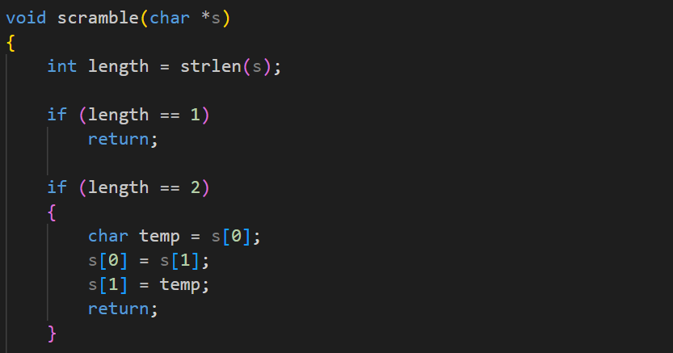
function:
function:

Slide 5
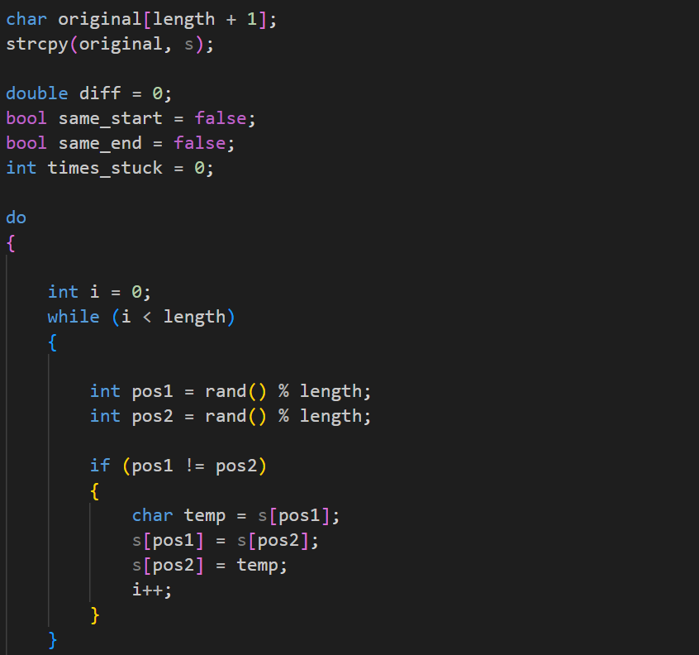
contd:

Slide 6
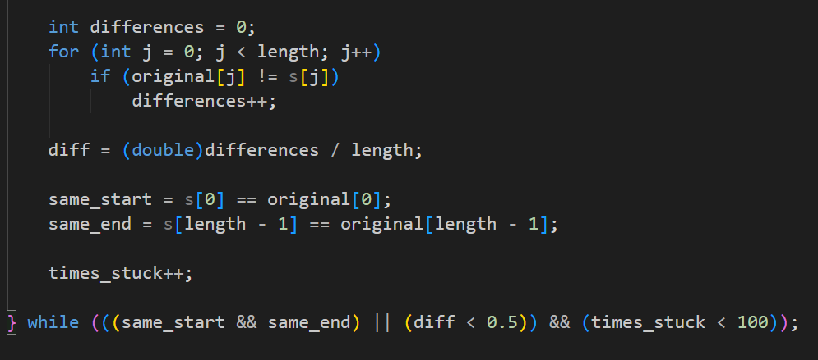
contd:

Slide 7

Output
for Singleplayer
01

Slide 8
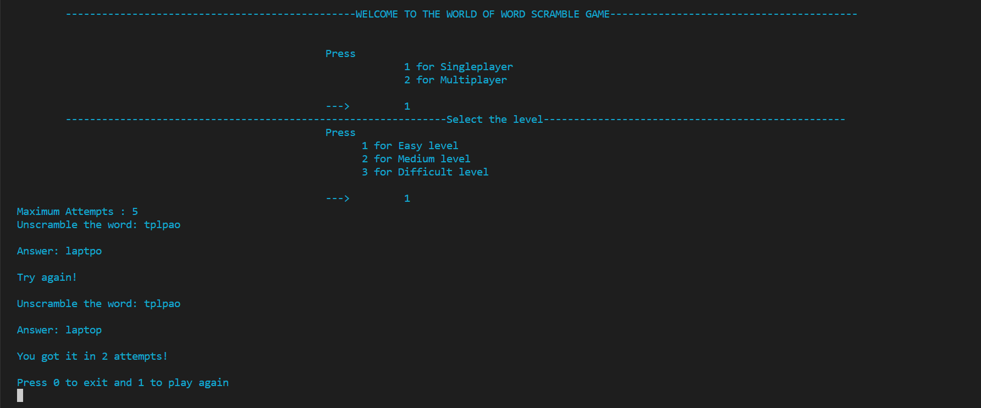

Slide 9
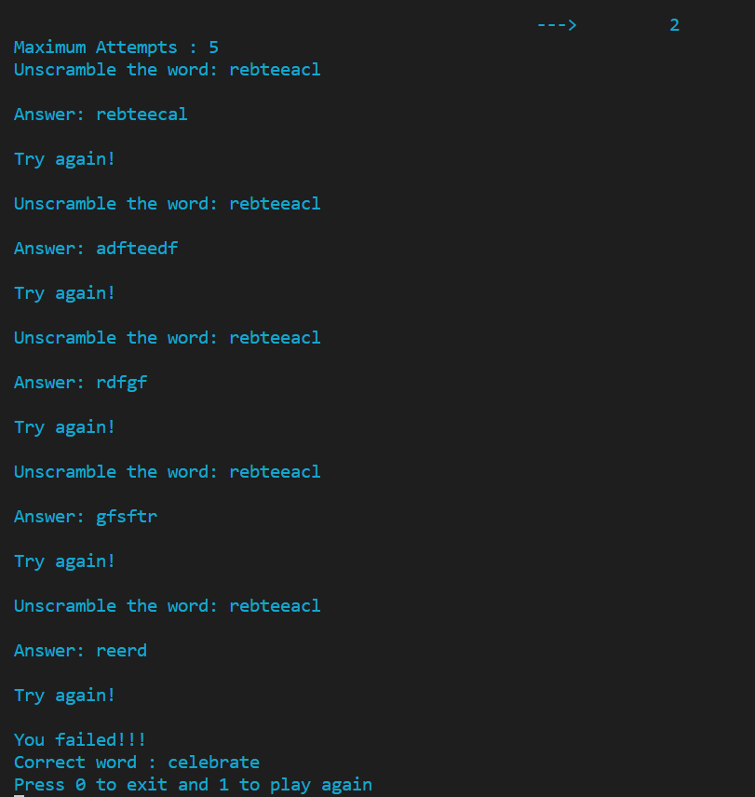
After, 5 failure

Slide 10
Output
for Multiplayer
02

Slide 11
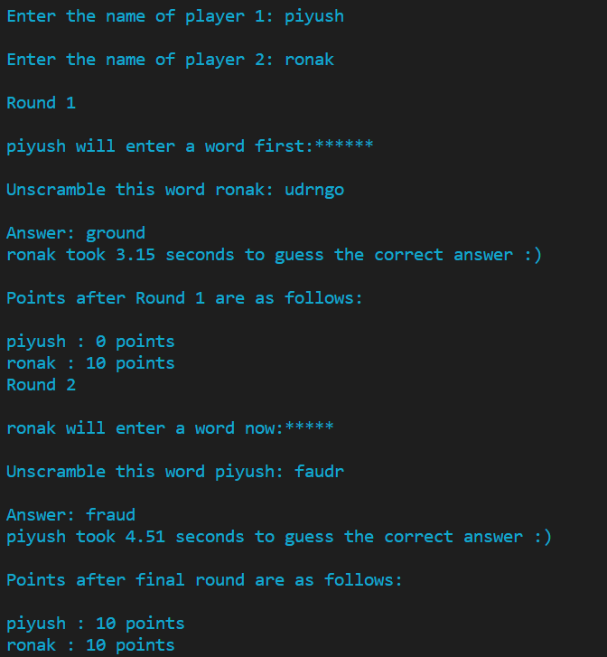

Slide 12

Thank you!

